Slide 1
Milestone Application
Jordan Mower
Jonathan Hua
Jordan Nienaber
Nick Luckey

Slide 2

Functional Obligations From SRS
3.2.1.1 Functional Requirement 1 - Registration
3.2.1.2 Functional Requirement 2 - Log In
3.2.1.3. Functional Requirement 3 - Add Course
3.2.1.4 Functional Requirement 4 - Delete Course
3.2.1.5 Functional Requirement 5 - Edit Course
3.2.1.6 Functional Requirement 6 - Add Task
3.2.1.8 Functional Requirement 8 - View Task
3.2.1.9 Functional Requirement 9 - Delete Task
3.2.1.10 Functional Requirement 10 - Complete a task
3.2.1.11 Functional Requirement 11 - Subscribe to Course
3.2.1.12 Functional Requirement 12 - Search for Courses

Slide 3
Tools & Technologies
AWS Amplify
Provided the backbone of our applications communication module.
GraphQL Schema Definitions using a NOSQL database.
User Authentication and management using Amazon Cognito UserPools.
Android Studio
IDE for developing android applications.
Provided easy to use XML Layouts for UI development.
Easy to add dependencies from third party developers.

Slide 4
Alterations
The user now only needs a username, given name, valid email, password, and phone number. The school defaults to CSUSM, and the rest of the required information is optional and accessed from the Profile page.
Removed some restrictions to unnecessarily tight controls over course and task names.

Slide 5
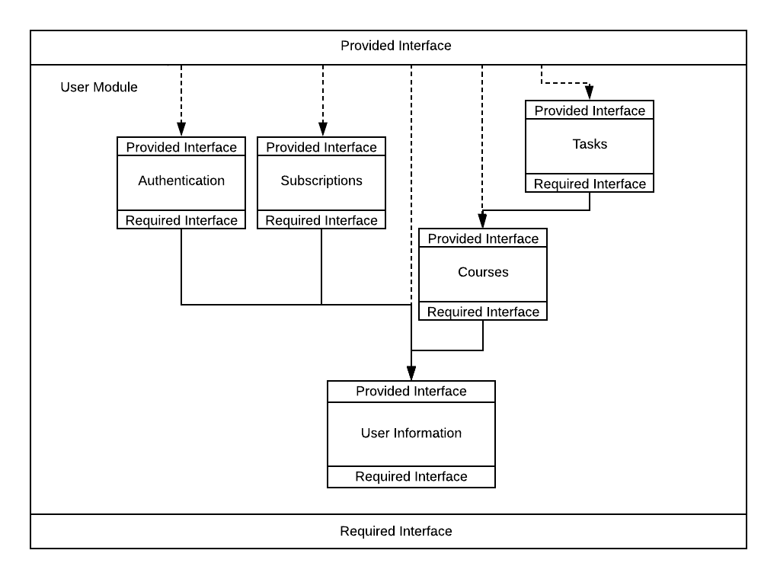
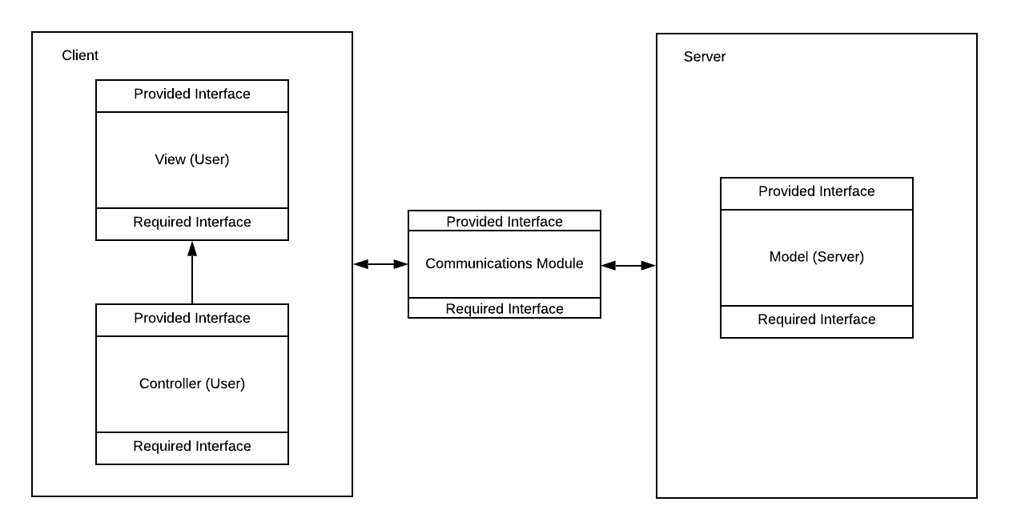
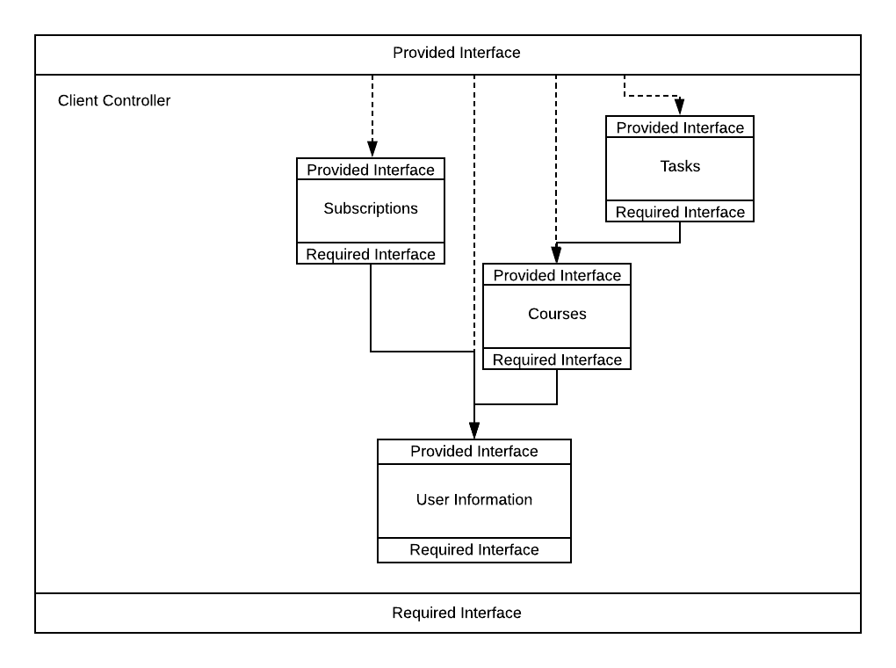
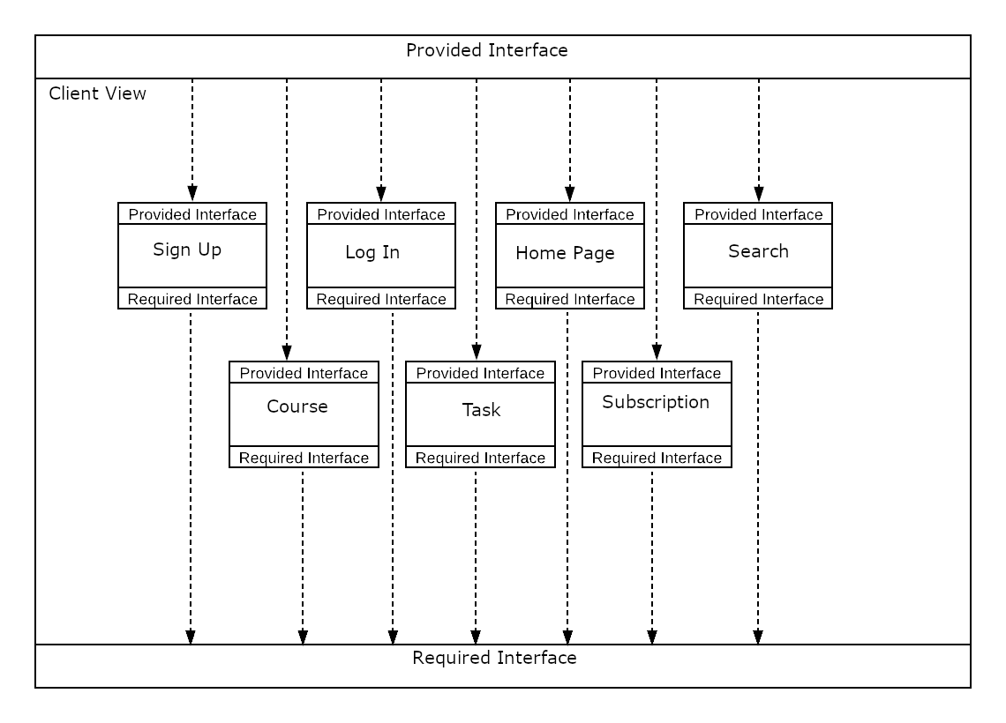
Architectural Obligations

Slide 6
Challenges
Team Challenges
No prior mobile development experience.
No experience with cloud based hosting.
No experience with AWS Amplify.
No experience with NoSQL & GraphQL.
Project Challenges
Transfer of course/task/user information between Android activities.
Solution: Singleton design pattern for static storage of information related to user.
Drawback: Required restructuring a lot of code.

Slide 7
Frontend Implementation: Activities/XML & Controllers
View
TaskViewActivity.java
TaskViewAdapter.java
UpcomingTaskAdapter.java
CourseMenuActivity.java
EditCourseActivity.java
EditTaskActivity.java
MainActivity.java
ProfileActivity.java
SubscriptionsActivity.java
SubscriptionsAdapter.java
AddCourseActivity.java
AddTaskActivity.java
AuthenticationActivity.java
Controllers
ClientFactory.java
CourseController.java
UserDataController.java
TaskController.java

Slide 8
Backend Implementation:GraphQL Schema
type Task @model {
id: ID!
author: String!
course: Course @connection(name: "CourseTasks")
coursename: String!
title: String!
duedate: String!
percentage: Float!
priority: String!
comments: String!
completed: Boolean!
}
type Course @model {
id: ID!
coursename: String!
instructor: String!
color: String!
meetingdays: String!
author: String!
tasks: [Task] @connection(name: "CourseTasks")
}
type UserData @model {
id: ID!
username: String!
schoolname: String!
birthday: String!
grade: String!
subscriptions: [String]!
firstVisit: Boolean!
}

Slide 9
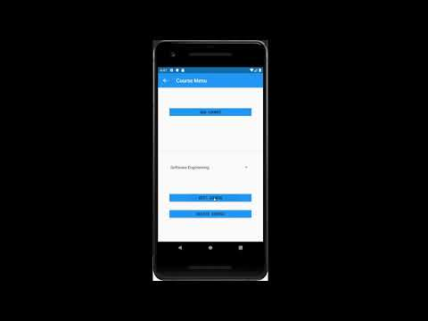
A Demonstration of a new user!

Slide 10
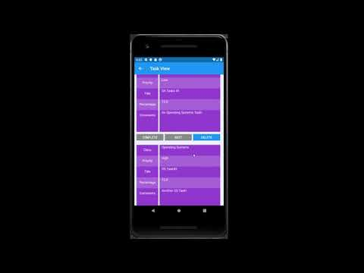
An Existing User Demonstration

Slide 11
From the Milestone Development Team:
Thank you!

